Slide 1
E-Commerce Brands
By
Sandhya S

Slide 2
Brands:
Nykaa
Lakme
Sugar Cosmetics
Mamaearth
Purple

Slide 3
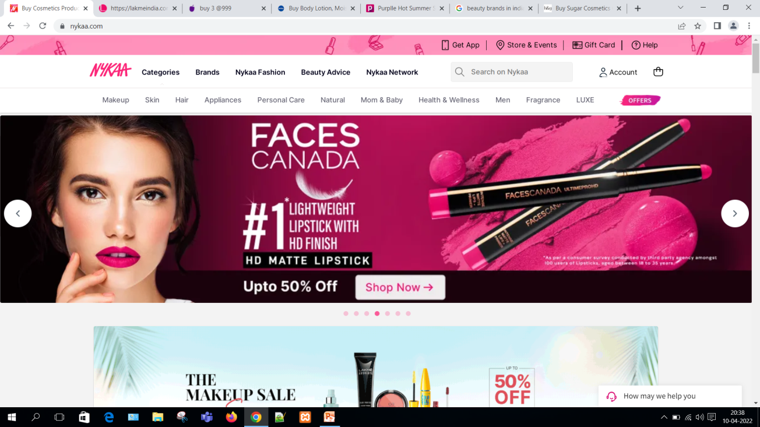
NYKAA https://www.nykaa.com/

Slide 4
NYKAA
Nykaa is India’s largest omnichannel beauty destination.
The theme of Nykaa is Pink.
The font used is Inter",sans-serif !important
Since their theme is pink they chose the links to be presented in pink shade.
The headings are in black shade while the contents are in light shades of color.

Slide 5
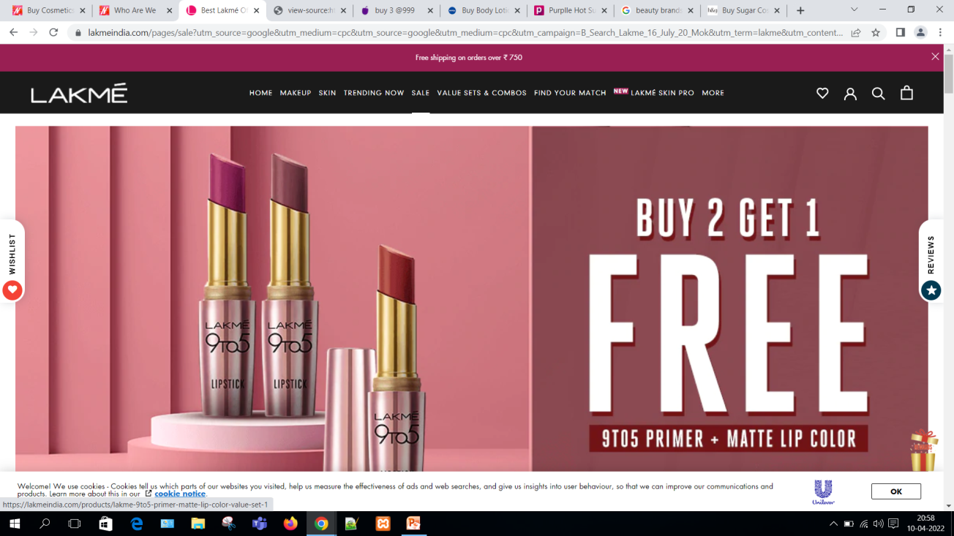
LAKME https://lakmeindia.com/

Slide 6
LAKME
Lakme is another cosmetic brand.
The theme of lakme is mix of dark shades.
The font used is DIN Neuzeit Grotesk,sans-serif;
The font are diiferentiated by their size to represent the headings and contents.

Slide 7
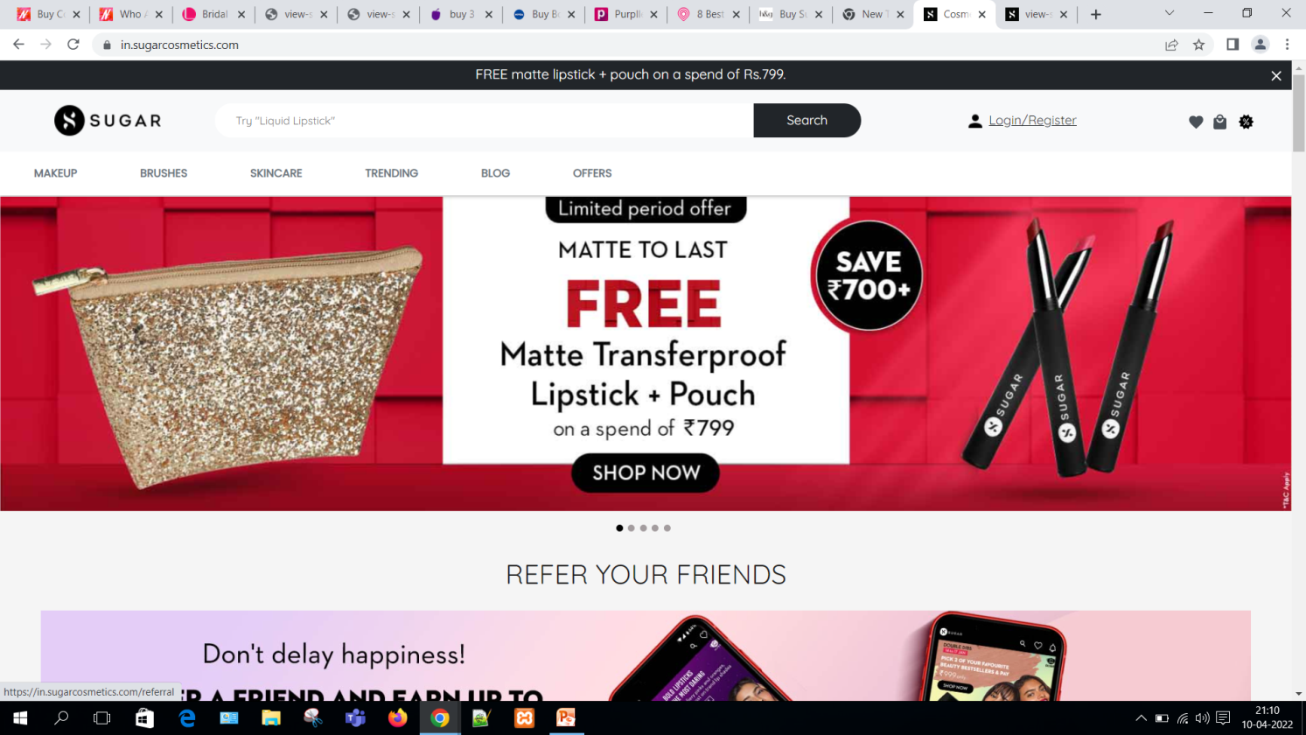
SUGAR COSMETICS https://in.sugarcosmetics.com/

Slide 8
SUGAR COSMETICS
A top-quality makeup brand for 21st-century women.
SUGAR Cosmetics is a storehouse of fun makeup and skincare products ranging from primers, foundations to lippers, eyeshadows to face brushes, moisturisers, face masks, and setting mists.
Font used is Quicksand;
The theme is black so they have used black colors for buttons .

Slide 9
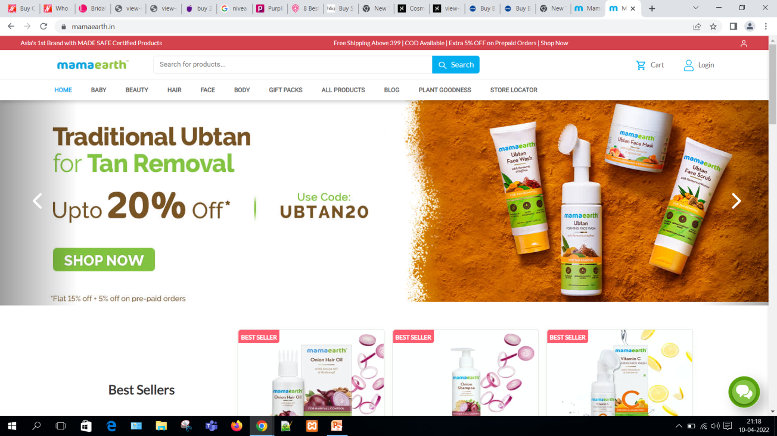
MAMAEARTH https://mamaearth.in/ MAMAEARTH https://mamaearth.in/

Slide 10
MAMAEARTH
Mamaearth is a brand that produces Toxin-Free, Natural Skin Care Products.
Their theme is of blue and green.
Font used is Lato;
The font are diiferentiated by their size to represent the headings and contents.

Slide 11
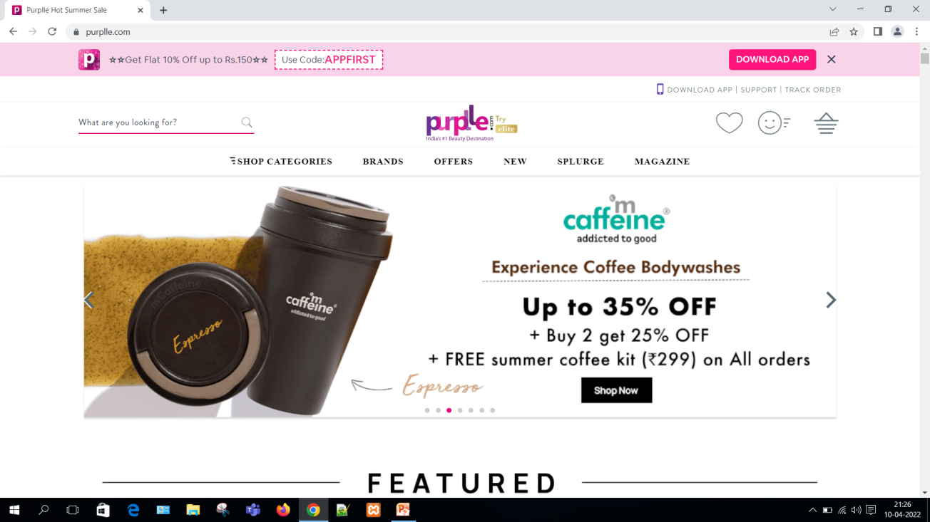
PURPLE https://www.purplle.com/

Slide 12
PURPLE
Purple is one of the beauty brands in India.
Their theme is light pink.
Font used is 'Aqleema-Regular';

Slide 13
THANK YOU

